Slide 1
Business Recommendations
CMPE 256 Spring 2019
Team T-Recs
Yuanjian Gao, Matthew Kwong, and Yi Lai

Slide 2
Introduction
Goal: to obtain experience in working with a rich dataset, by generating recommendations in a useful domain
Main idea: use Google Local business reviews to recommend businesses of interest to a user
For our project, we chose to focus on businesses in the Santa Clara County only

Slide 3
Dataset
Review data (11,453,845 records): business ID, user ID, rating, review text, categories, and timestamp
User data (4,567,431 records): user ID, name, current location (99+% missing), education (99+% missing)
Business data (3,116,785 records): business ID, name, address, hours, phone, GPS.

Slide 4
Problems Addressed
Transform the huge raw JSON files into a digestible format (.csv), and filter Santa Clara County data
Provide an efficient business search engine based on location and category
Find the top 10 recommended businesses for a user, based on the user’s previous reviews of other businesses
Visualize the searching result and recommendations on a map

Slide 5
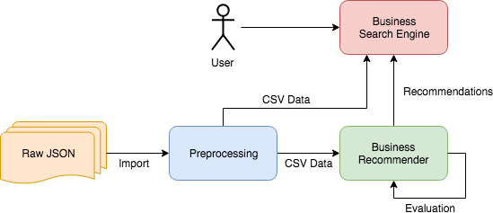
Architecture

Slide 6
Preprocessing
Import raw JSON into Python
Extract only Santa Clara County data
Data cleaning
Feature selection & transformation
Users: user ID, current location
Businesses: business ID, name, address, gps
Ratings: user ID, business ID, rating, categories, timestamp, gps
GPS string -> latitude, longitude
Categories -> one hot encoding

Slide 7
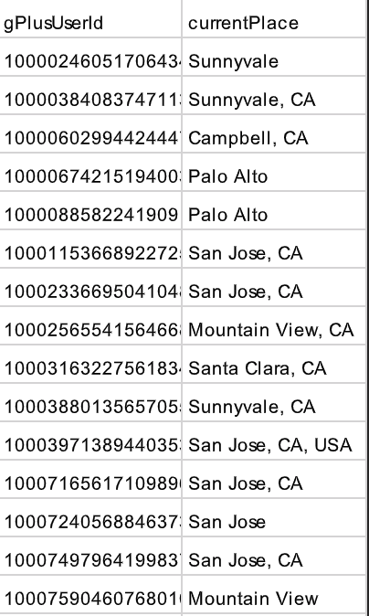
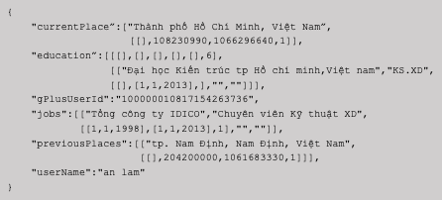
Users: majority count of their reviewed businesses

Slide 8
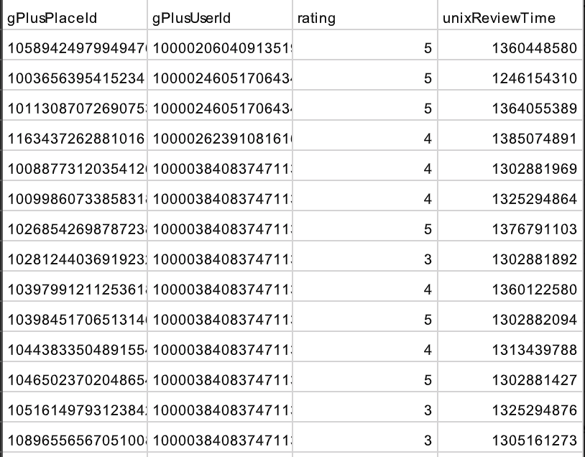
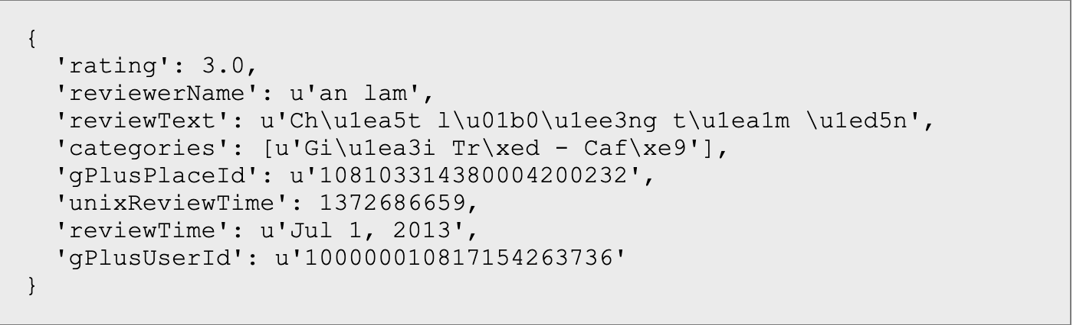
Reviews: filtered by Business and Users in SSC

Slide 9
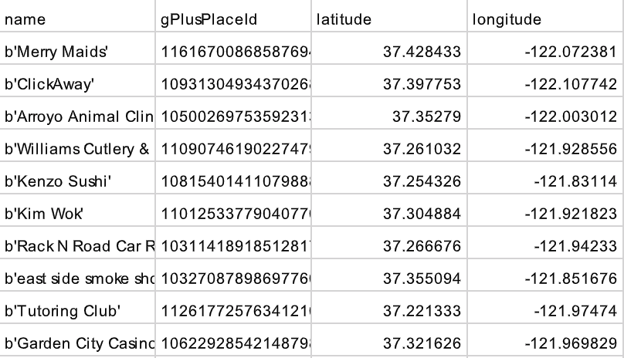
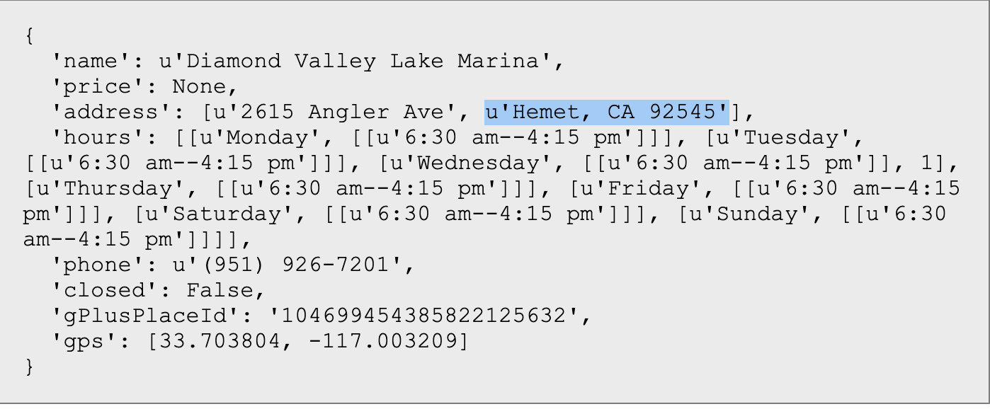
Business: filter by city (15 in SCC)

Slide 10
Problems In Preprocessing
Memory: when extracting data from such a large dataset, it is easy to run out of memory. To solve this problem, we increased the virtual memory size of the desktop.
Unicode: some JSON data uses the unicode format which is a problem when we use it. We used the AST Python library to convert the unicode into utf-8.
Invalid GPS coordinates: some GPS data was malformed, with the decimal point is in the wrong position (e.g. 37123456.0, 121987654.0). We used regular expressions to correct the decimal point position in these records.

Slide 11
Preprocessing
From business dataset to generate the place data filtered by city name and zip code. Then generate a list of unique placeID for filtering the other data.
From reviews dataset to get the data filtered by the placeID list and get the list of unique userID
From user dataset to get the data filtered by current place and the userID list. Then generate a new list of unique userID.
Using the new userID list to filter out the reviews and store into a file called sscUserReviews
Setting a threshold based on the review times of each reviewer, filter out those we thought is not citizens of Santa Clara County
Combining the filtered reviews data and sscUserReviews, then remove the duplicate data

Slide 12
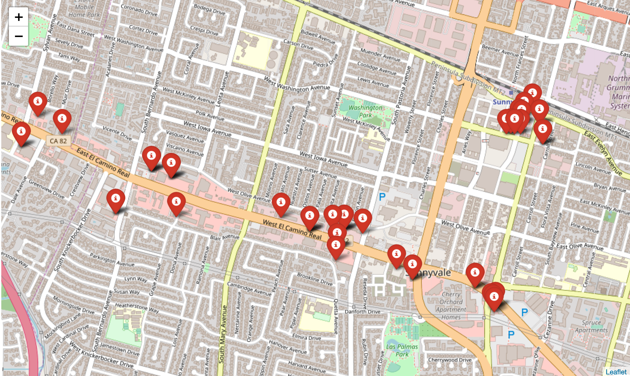
Business Search Engine
Input:
Categories
Location
Review Rating Threshold
Review Count Threshold

Slide 13
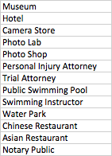
Business Engine - Improve Search Coverage
Challenge:
The categories given for each business are often not comprehensive, many businesses to be left out when a single category is used as a filter.
Solution:
Regroup the 1537 categories into 30 types represented by the numbers 1-30.

Slide 14
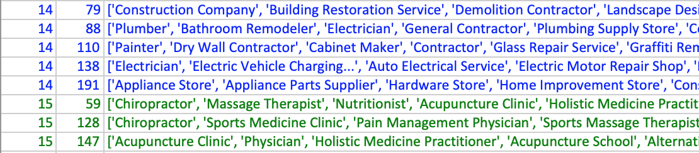
Business Engine - Improve Search Coverage
One-hot encoding of categories for each business
Group businesses into 220 subtypes using K-Means based on the categories vector
Smaller K vs. Bigger K
3. Regroup the 220 subtypes into 30 types by K-Means based on text clustering.

Slide 15
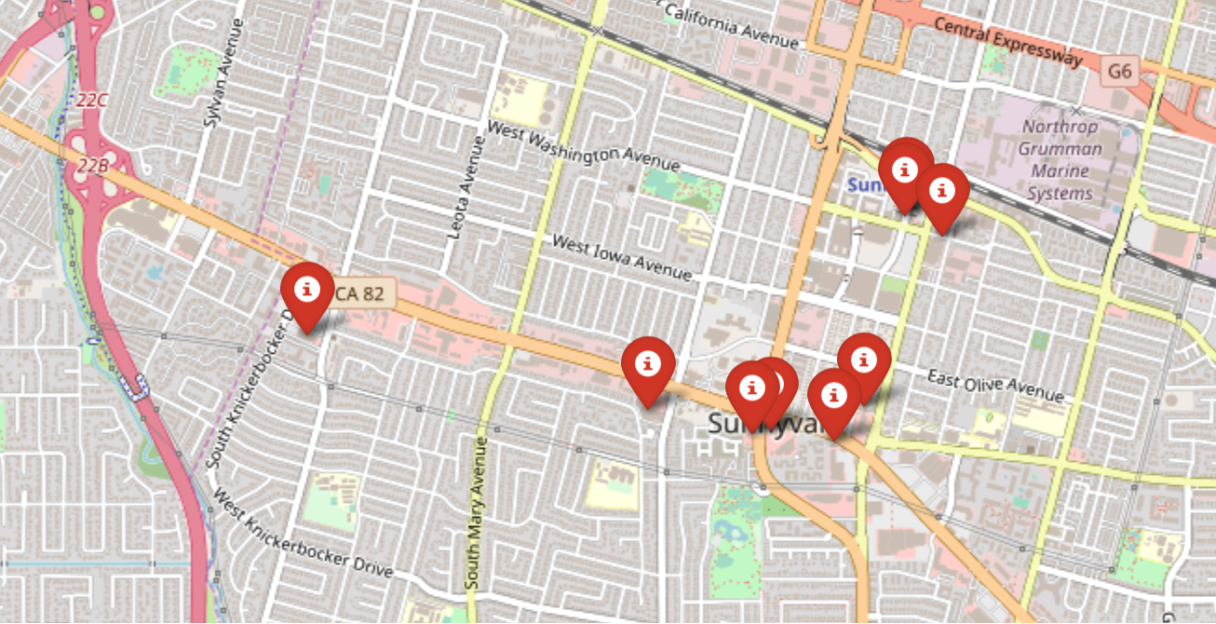
Business Engine - Improve Search Coverage
Assign ”Beauty Salon“ ------------> cluster 14:
['Beauty Salon', 'Hair Salon', 'Cosmetics Store', 'Day Spa', 'Skin Care Clinic', 'Waxing Hair Removal Service', 'Massage Therapist', 'Hair Care', 'Wig Shop', "Children's Clothing Store", 'Religious Goods Store', 'Wedding Store', 'Beauty Supply Store', 'Tanning Salon', 'Store', 'Spa', 'Body Piercing Shop', 'Reflexologist', 'Facial Spa', 'Portrait Studio', 'Nail Salon', 'Cancer Treatment Center', 'Beauty School', 'Car Detailing Service', 'Casino', 'Massage']
Prediction the cluster of “the nearby school” by the trained model.
Before
After

Slide 16
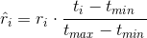
Algorithm Variations & Evaluation
GridSearchCV 75/25 train/test split (evaluated using RMSE and MAE)
SVD
KNN
Co-Clustering
“Anti”-test set
Ratings variations in the training data
Raw rating
Mean-centered rating
Timestamp-normalized rating (multiply the rating by the min-max normalized timestamp)
Mean-centered AND timestamp-normalized rating

Slide 17
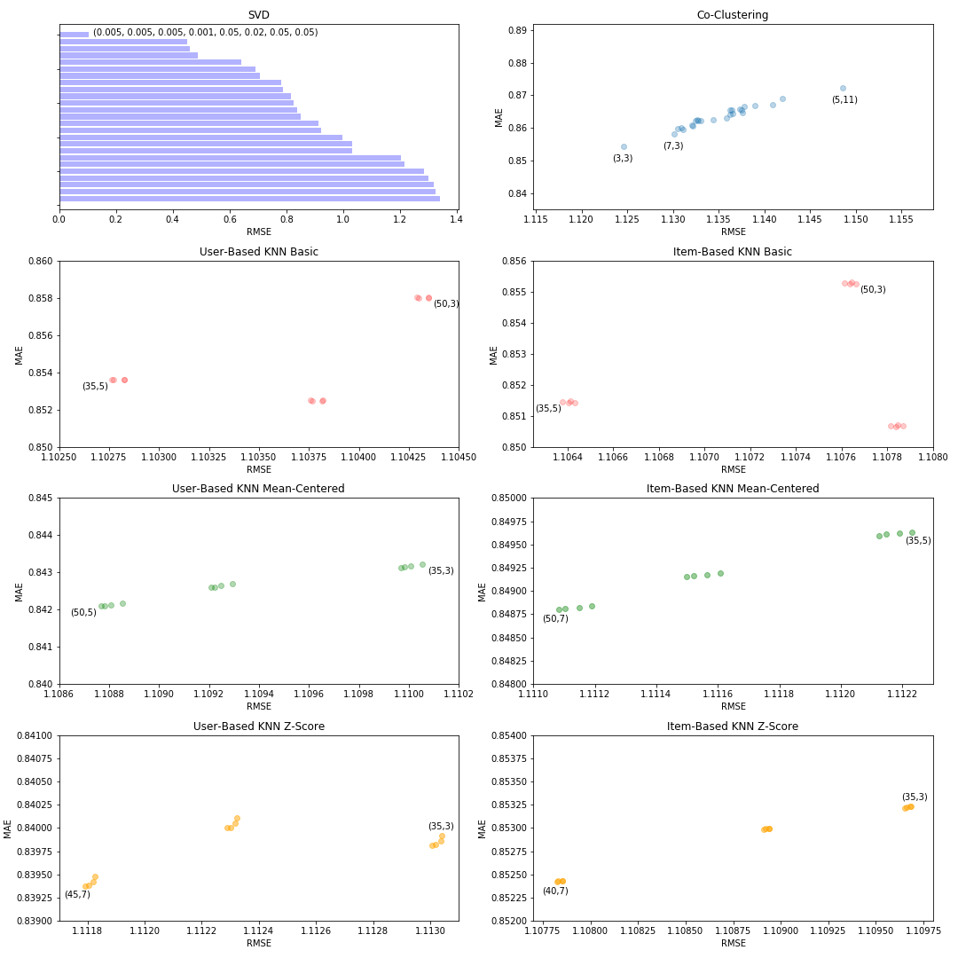
Algorithm | RMSE | MAE | Parameters
SVD | 1.000104164 | --- | lr_bu=0.005, lr_bi=0.005, lr_pu=0.005, lr_qi=0.001, reg_bu=0.05, reg_bi=0.02, reg_pu=0.05, reg_qi=0.05
KNN basic user | 1.102765627 | 0.853629175 | k=35, min_k=5
KNN basic item | 1.106378672 | 0.8514354132 | k=35, min_k=5
KNN z-score item | 1.107823041 | 0.852417666 | k=40, min_k=7
KNN means user | 1.108768277 | 0.8420876861 | k=50, min_k=5
KNN means item | 1.111083018 | 0.8487991044 | k=50, min_k=7
KNN z-score user | 1.111791521 | 0.8393765511 | k=45, min_k=7
Co-Clustering | 1.124588327 | 0.8544638485 | n_cltr_u=3, n_cltr_i=3

Slide 18
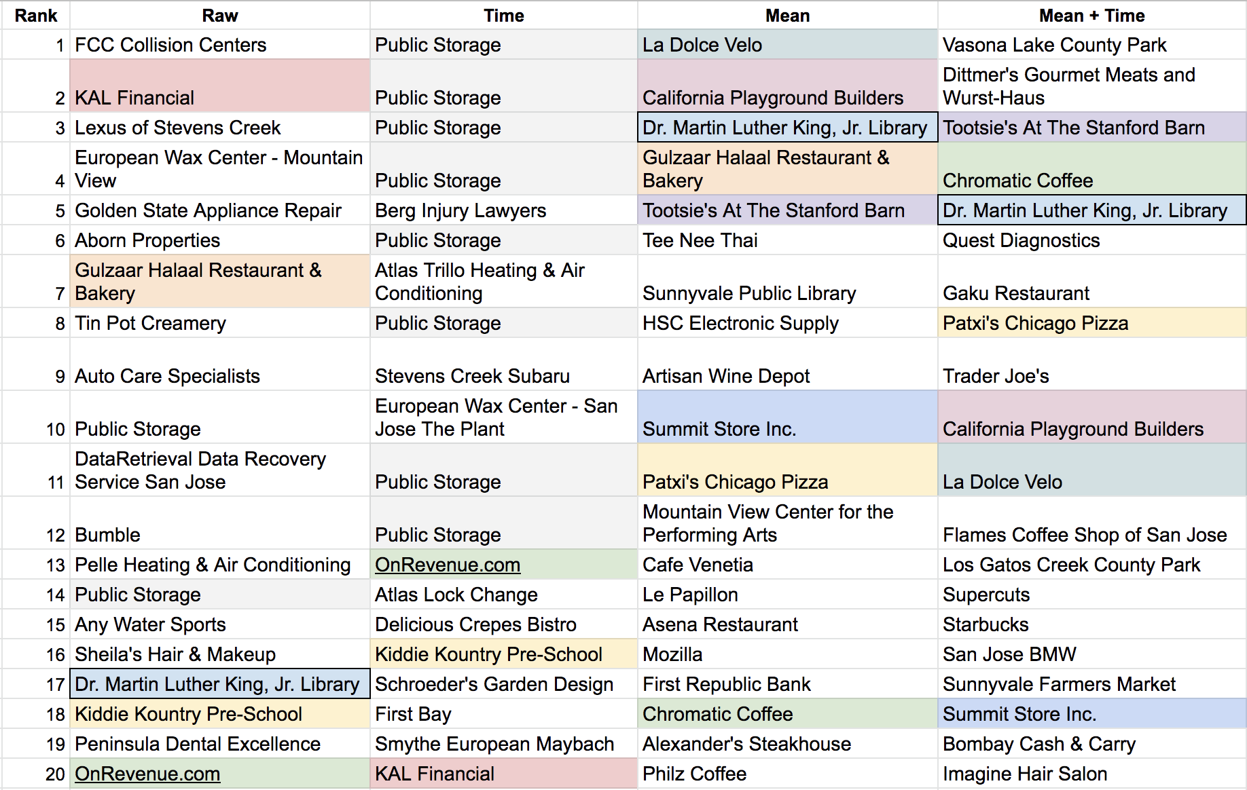

Slide 19
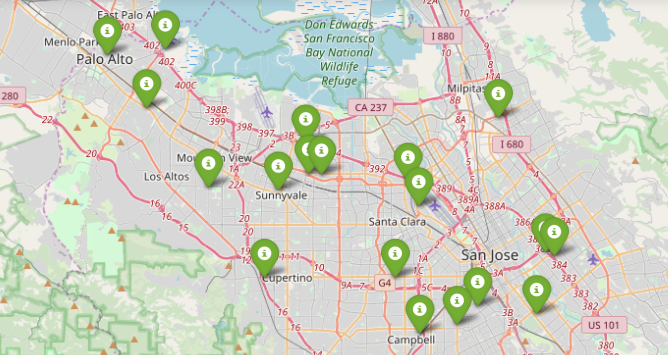

Slide 20
Conclusions
Data subset was a good size
Rich dataset has many options
Stick to conventional normalization methods
We make a good team

